Slide 1
iPhone Podcasting
IET09 Online Presentation
RICHARD JONES BES AGDD(T) MDE

Slide 2

Introductory Video
IET09
Richard
Jones
Apr 01
2009

Slide 3
Tools Used - Computers
The Net
  Disk Farms, Servers, Routers, Switches, Optical Fibre , Copper Wire and Lots of Clean Power
Personal Computers
  Toshiba Tecra and MacBook Pro
    Safari, Firefox (FireFTP), Quicktime Pro, Jing Pro (mp4) and Garageband or Audacity

Slide 4
Tools Used – Smart Phone
Apple iPhone 3G
  Safari (less Flash, JAVA, mov), WordPress App (text, images), Google App (gmail, Reader, Photos, Maps), HT Professional Recorder (wav)
iPhone Ear Buds and Mic
Many, Many Battery Charge Cycles

Slide 5
Tools Used - Visuals
Video
  Built-in Apple iSight camera (mov)
  Samsung SC-HMX10A HD camcorder (mp4, HD)
Images
  Canon PowerShot A570IS (jpg)
  Built-in Apple iSight camera (png)

Slide 6
Tools Used - Aurals
Audio
  Audio-Technica AT2020 large diaphram voice microphone and Shure SM-57 microphone
  M-Audio Fast Track Ultra 8-channel mixer and pre-amplifier with software mixing board
  Assorted stands and cables

Slide 7
Systems and Hosts
screencast.com and slideshare.net
  mp4, png, jpg embedding
Google
  Gmail, Reader, Picasa, Google Earth
thestoryshop.net/blog/
  WordPress, cPanel, BluBrry PowerPress, Google Reader

Slide 8

HT Professional Recorder App
Applied Voices LLc
  High Quality Capture
  Novel and Accessible UI
  Simple FTP Setup
  WiFi Broadcast Enabled
  Gain Control for Better Capture at a Distance

Slide 9
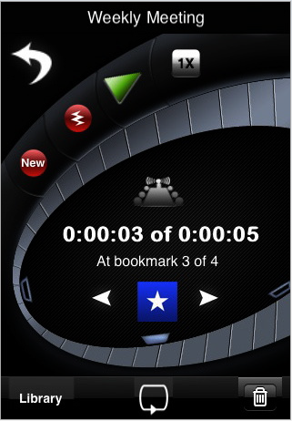
HT Professional Recorder App
Single screen recording
Intimate, boardroom or hall capture settings
Bookmark segments
Speed adjustment
Innovative layout

Slide 10
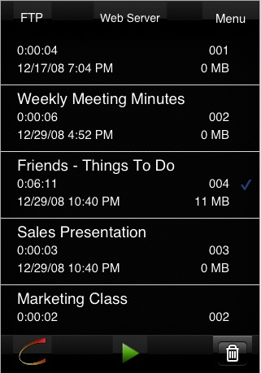
HT Professional Recorder App
Library in WAV format
Play or upload to Web
Wi-fi broadcast server
Menu includes the Owner’s Manual, FTP settings and startup option

Slide 11
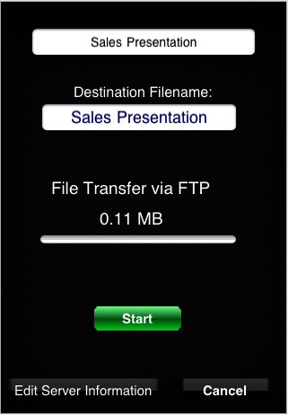
HT Professional Recorder App
One click file transfer
Simple setup for FTP server configuration (hostname, credentials, directory)
Record and upload from an iPhone

Slide 12

HT Professional Recorder App
Broadcast to your local network
Simple on or off function
Domain specific
Password protected

Slide 13
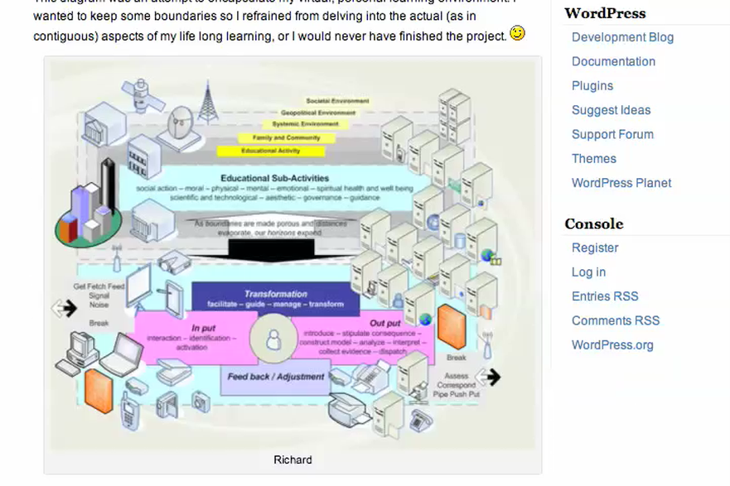
WordPress at thestoryshop.net

Slide 14

WordPress App
Open Source
  Built by WordPress Community
  Compose, Upload and Manage Posts, Pages, Comments and Images
  Well Integrated

Slide 15
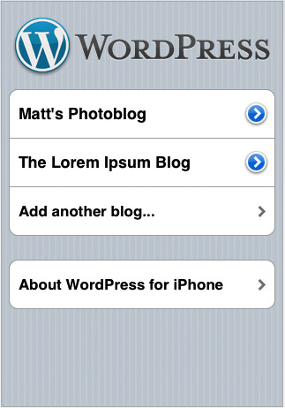
WordPress App - UI
Manage multiply WordPress blogs
Add a blog with URL and credentials
  Includes settings for displaying a desired number of posts
  and photo resizing

Slide 16
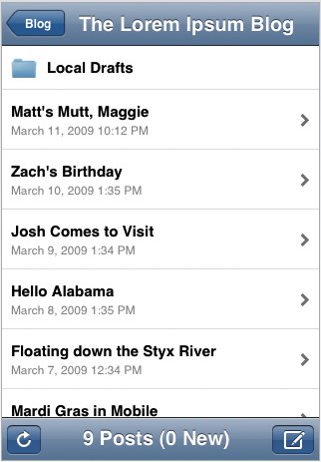
WordPress App - Content
Access to Posts, Pages and Comments folders
Create and edit including adding categories and tags
Add photos and preview results before publishing

Slide 17
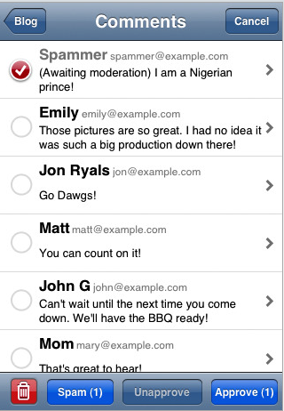
WordPress App - Comments
Manage comments
Approve, delete and reply
Simple touchscreen management

Slide 18
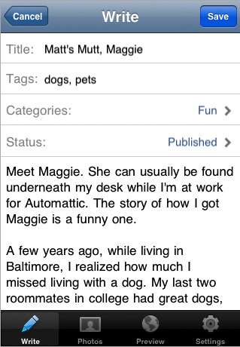
WordPress App - Writing
Compose Posts, Pages or Comments
Password protection settings
Resize photo settings
Preview content

Slide 19
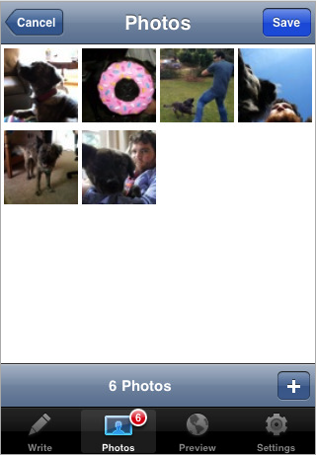
WordPress App - Photos
Manage Photos including Camera Roll sets
Add photos from library or take photos with iPhone camera
Attach to uploads

Slide 20
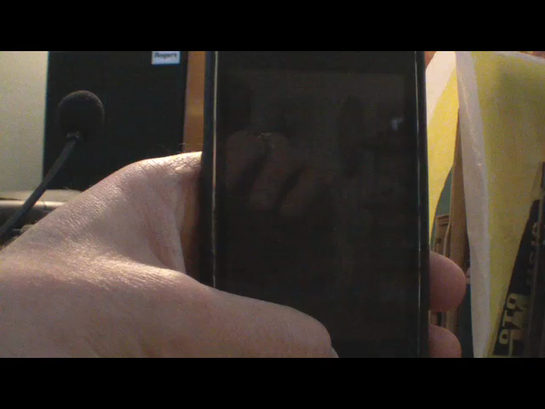
Apps on the iPhone

Slide 21
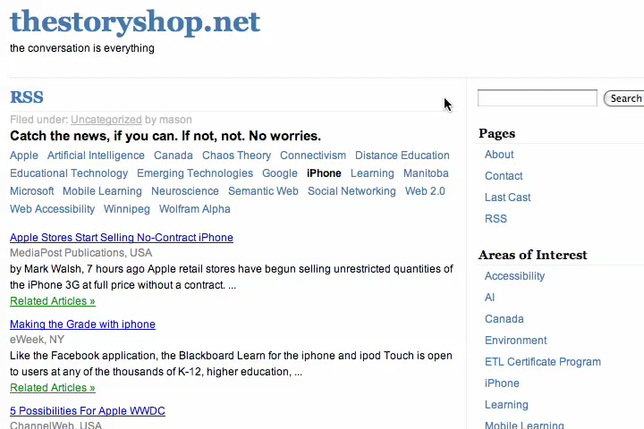
RSS Page at thestoryshop.net

Slide 22
Final Thoughts
Identity/Account Management is an Issue
  Many account names, passwords, profiles and network nodes to manage
  Not always able to choose a consistent userID
File Format Consistency is Important
  iPhone is limited by the formats it handles
  Choose apps that create files in common formats that all browsers can display
Bandwidth is Limited, Design Accordingly

